Slide 1
Bot!Battle!:
Game Display Team
Josiah Hertzler
Taha Siddique Jack McFann
Tom Hoffman Sawyer Brown

Slide 2
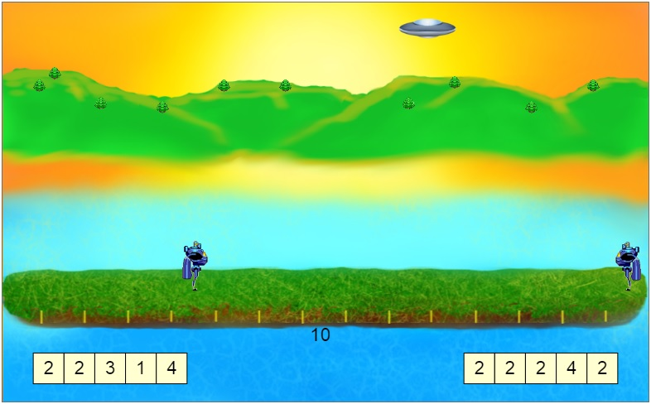
The Big Picture

Slide 3
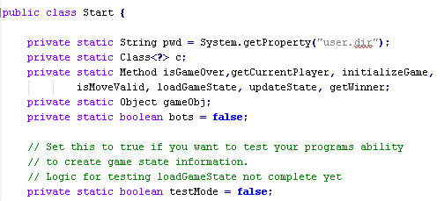
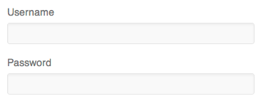
Three Main Tasks
Game Evaluation
Game Display
Web Service

Slide 4
Our Job
Flexible animation commands
Intuitive replay screen
A space for users to test code
Creation of a Game Challenge

Slide 5
Design Phase

Slide 6
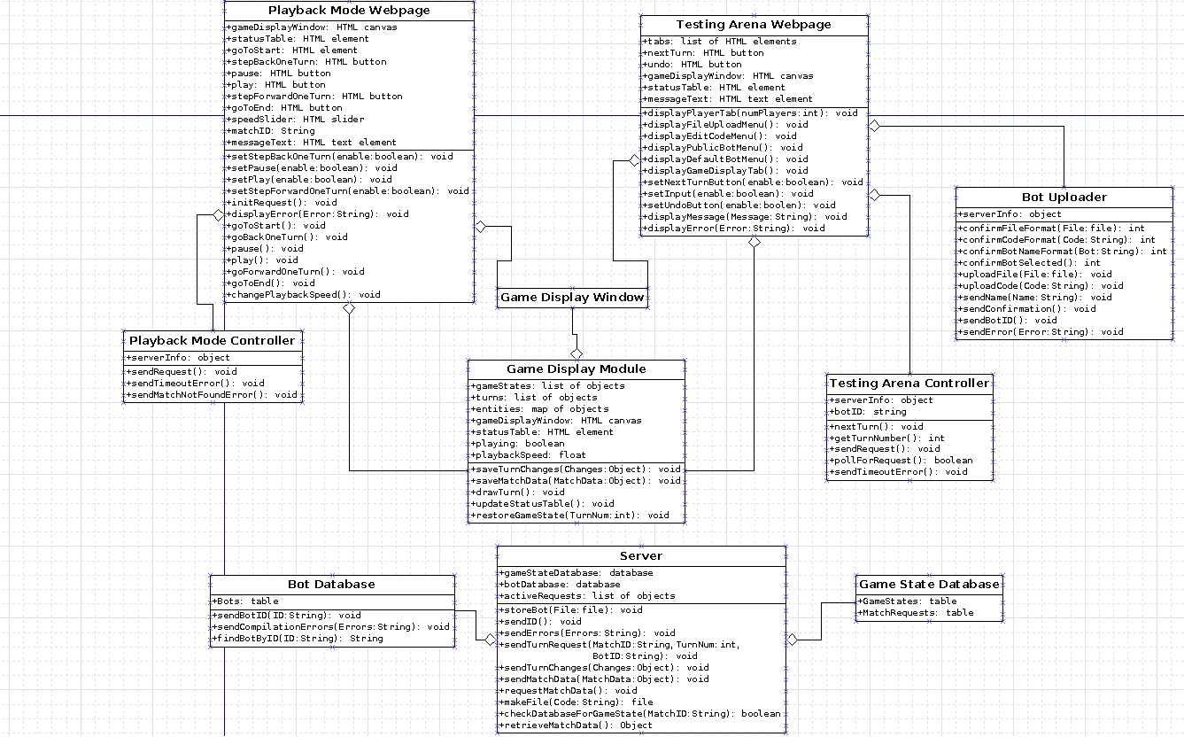
Testing Arena
Playback Mode

Slide 7
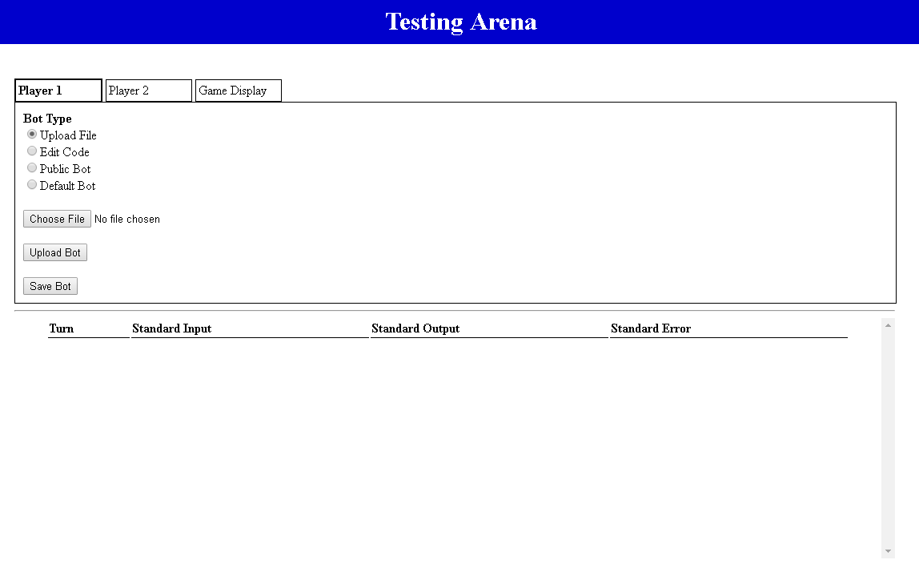
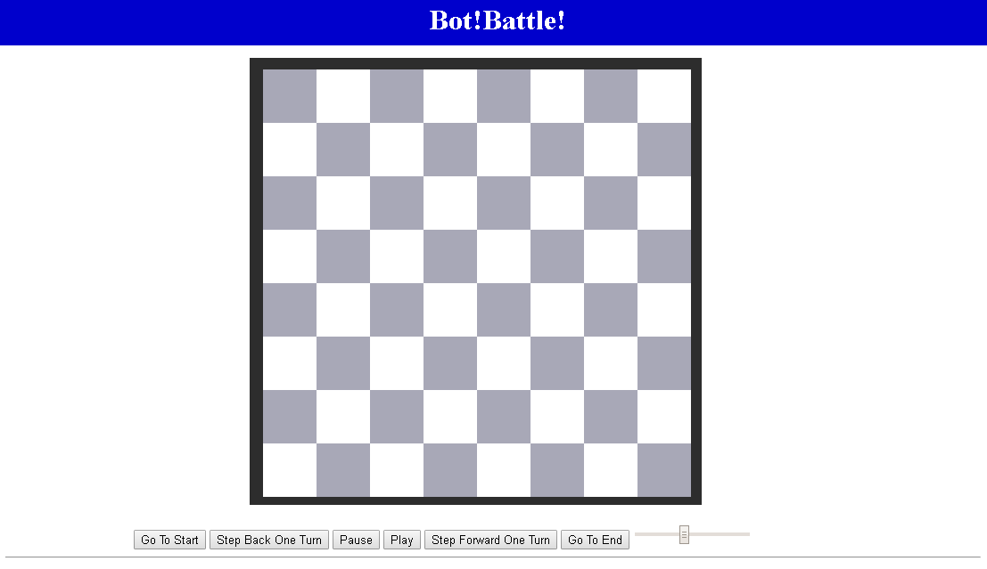
Displaying A Game
Playback Mode
Testing Arena

Slide 8
Playback Mode
View completed matches
Speed Slider
Turn by turn
Easy to use

Slide 9



Slide 14


Slide 15



Slide 16
Testing Arena
Debugging Display
Alter your bot
Upload File
Edit Code
Test other bots
Public Bot
Default Bot

Slide 18
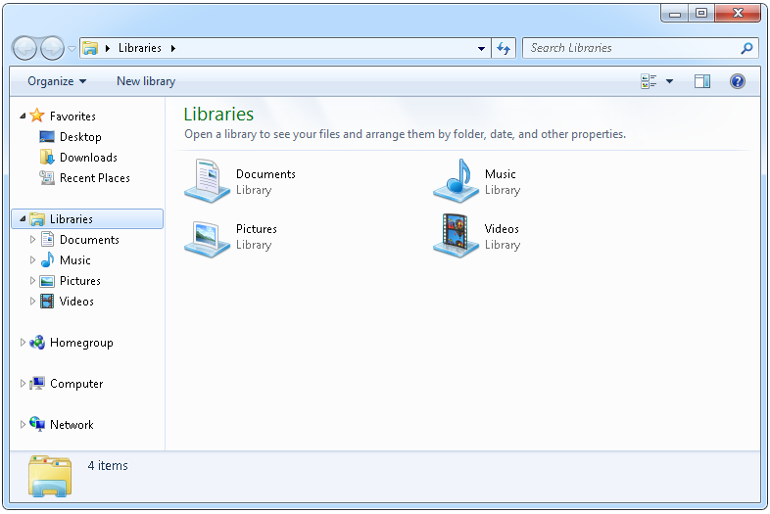

Slide 19
//Template Code for bot
public static void main(String args) {
System.out.print(“Hello!”);
}

Slide 22
Game Challenges

Slide 23
Capture The Flag
Math Based Game Challenge
Many layers of strategy
Aggressive vs Conservative
Attack Focus vs Defense

Slide 24


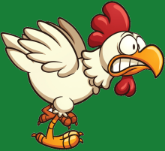


Flags Captured: 0
Flags Captured: 0

Slide 25
Questions?

